Slide 1
Spring Boot
Spring makes Java:
Simple, modern, productive, reactive, cloud-ready.

Slide 2
Agenda
Spring Boot
Spring Boot Starters
Spring MVC

Slide 3
Homework
Utilize necessary starters for Spring Boot.
Configure settings (such as database connection) using application.properties, with separate configurations for default and production environments.
Implement a user interface using either Thymeleaf.
Implement on the UI all functionalities that were available through the console.
Implement a history feature on the UI, allowing users to select a date range and providing pagination (if implemented in previous assignments).
Make sure to adhere to best practices for Spring Boot application development, including proper project structure, dependency management, and error handling.

Slide 4
Spring Boot

Slide 5
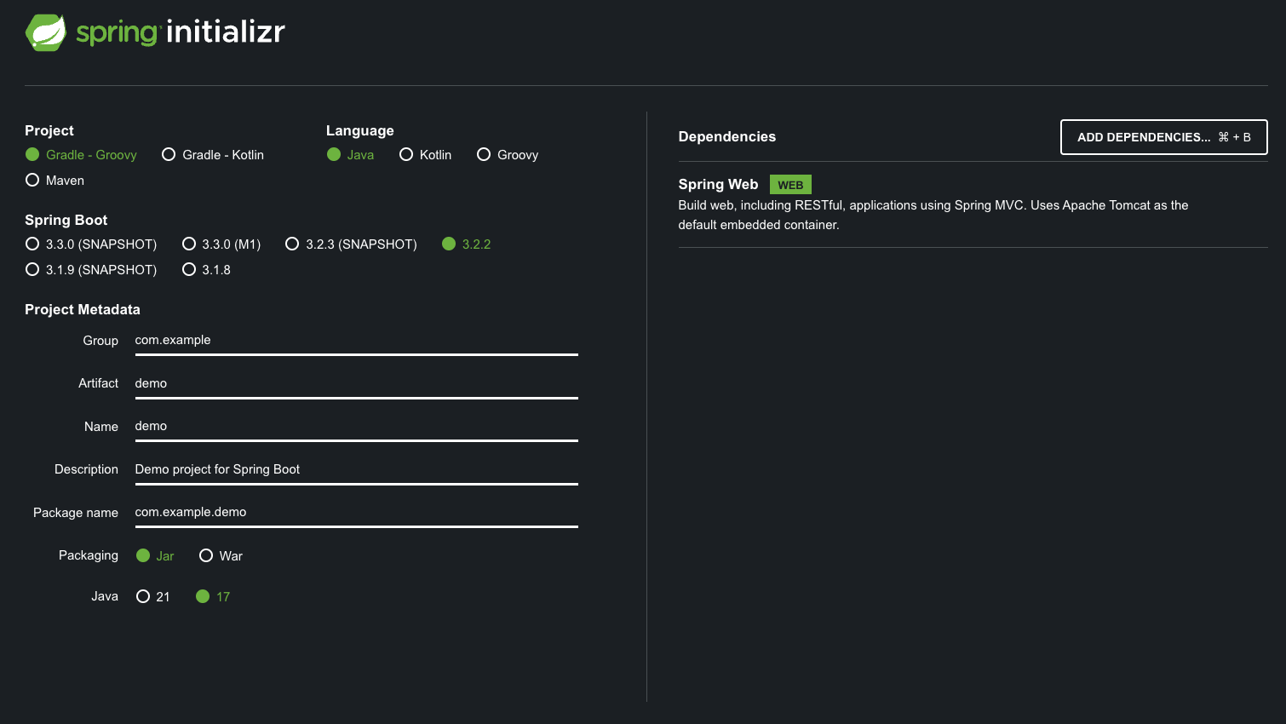
Spring Boot (https://start.spring.io/)

Slide 6
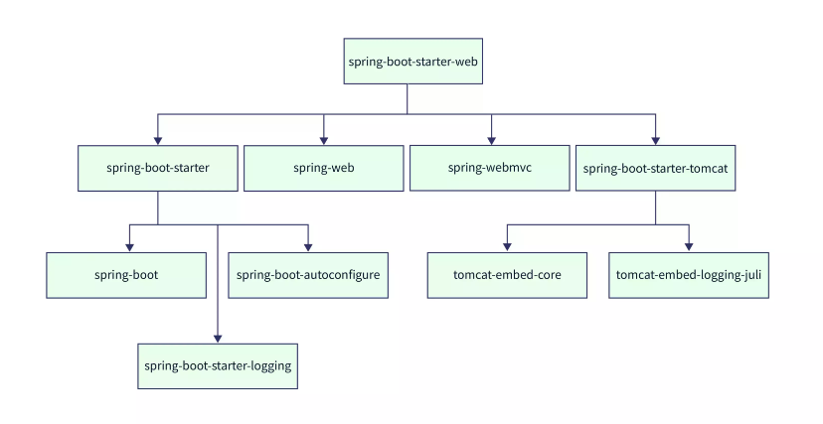
Spring Boot Starters
spring-boot-starters

Slide 7
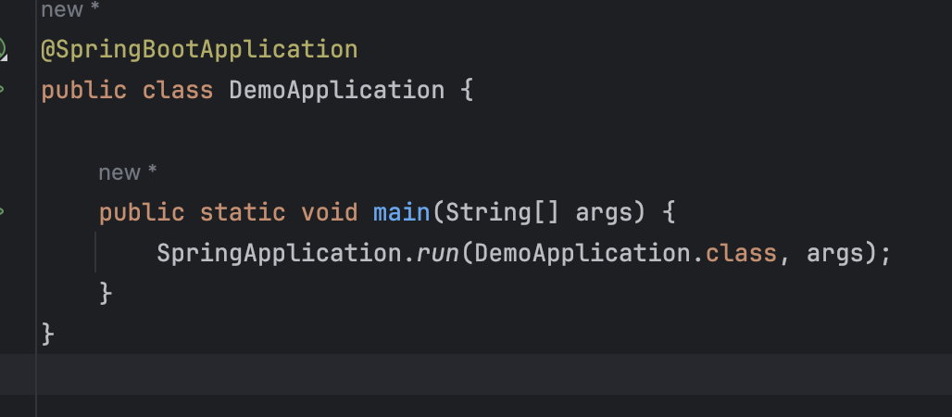
Spring Boot Application

Slide 8
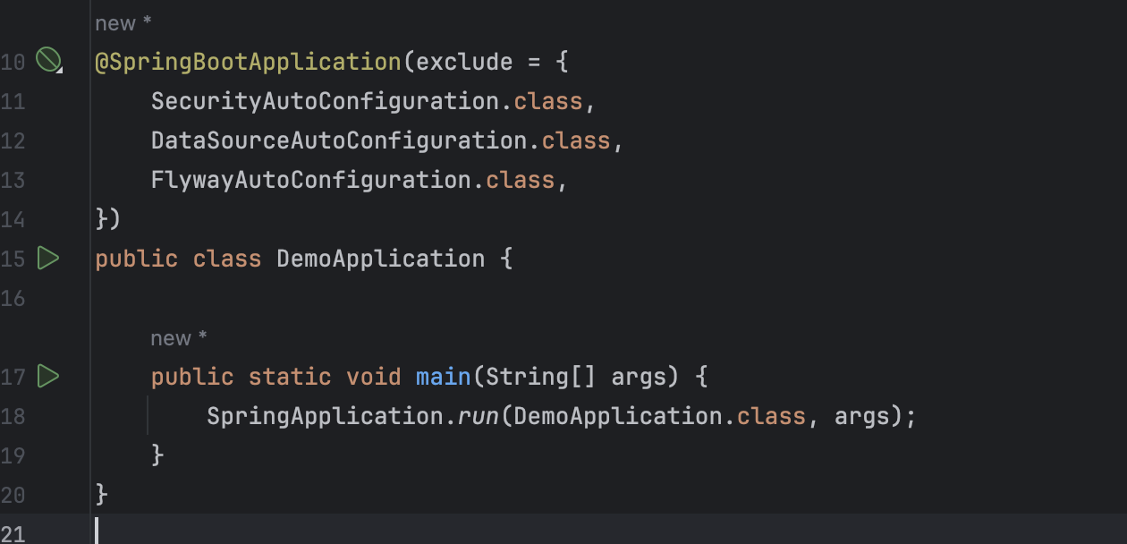
Exclude AutoConfiguration.class

Slide 9
MVC
is an abbreviation for a design pattern

Slide 10
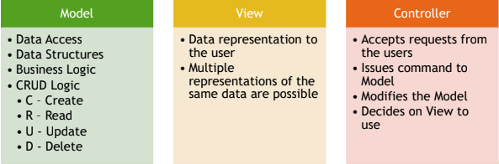
MVC is an abbreviation for a design pattern.
MVC stands for Model-View-Controller, it is a design pattern which divides
application into three main interconnected component types.

Slide 11
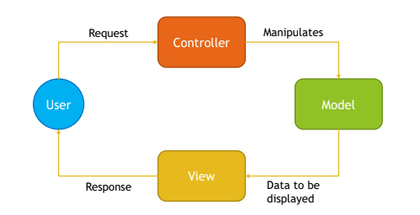
MVC

Slide 12
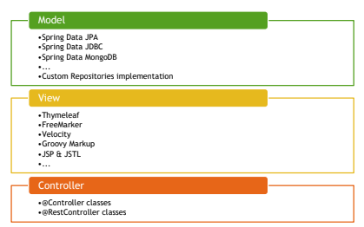
Spring MVC

Slide 13
What is Tomcat
Apache Tomcat (or simply Tomcat) is an open source web server and servlet container developed by the Apache Software Foundation (ASF). Tomcat implements the Java Servlet specifications from Oracle, and provides a "pure Java" HTTP web server environment for Java code to run in. In the simplest config Tomcat runs in a single operating system process. The process runs a Java virtual machine (JVM). Every single HTTP request from a browser to Tomcat is processed in the Tomcat process in a separate thread.

Slide 14
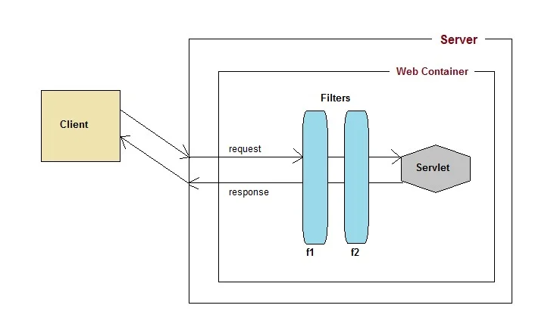
Server

Slide 15
Servlet
Servlet is a Java Technology used to create Web Applications on Java Platform with usage of Application Servers. It is a set of interfaces, classes and documentation allowing you to extend capabilities of Application Servers.
Servlet is protocol independent, however usually it is used to process HTTP Requests with usage of custom implementation of HttpServlet class.
Servlet can be registered via web.xml, or programmatically via annotations since Servlet 3.
Servlet registration requires url-patterns which informs application server which requests should be mapped to your servlet.

Slide 16
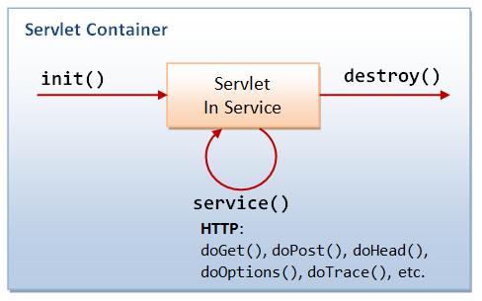
Servlet Container

Slide 17
Dispatcher Servlet
Delegates received requests to Controllers
Uses View Resolvers to resolve views pointed out by Controllers
Produces Response that is sent to user
Handles shared concerns, like exception mapping, error handling, security etc.

Slide 18
Controller
@RequestMapping
@GetMapping
@PostMapping
@PutMapping
@PatchMapping
@DeleteMapping

Slide 19
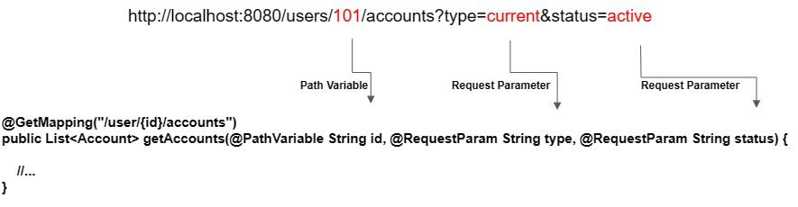
Mapping

Slide 20
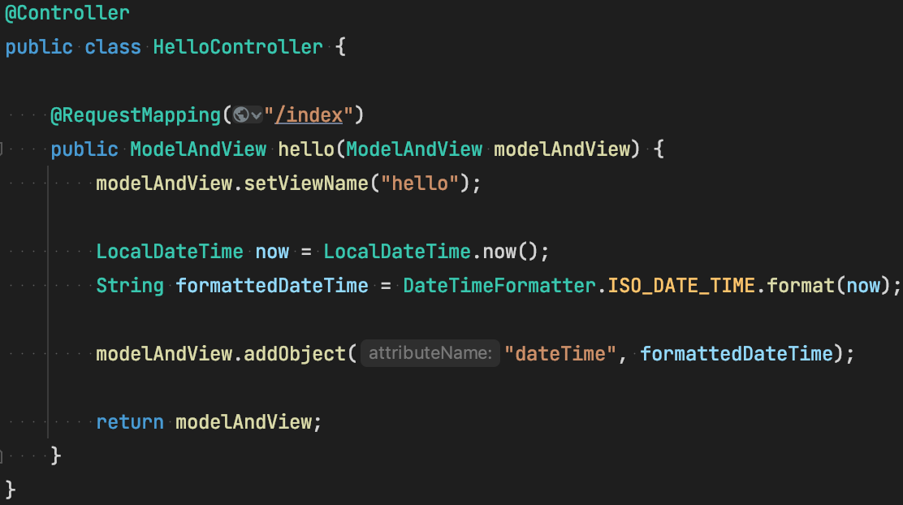
Spring Web MVC - Controller and Model

Slide 21
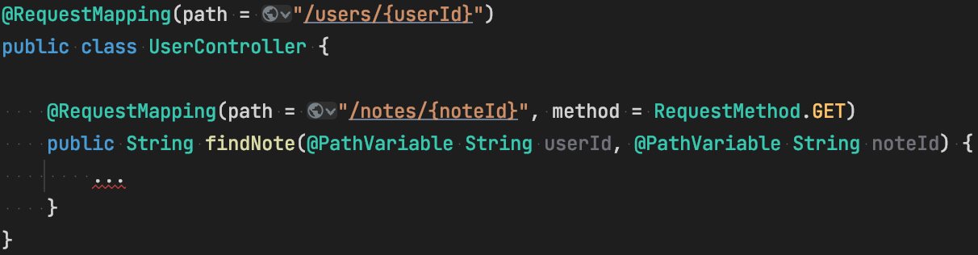
@RequestMapping - Details

Slide 22
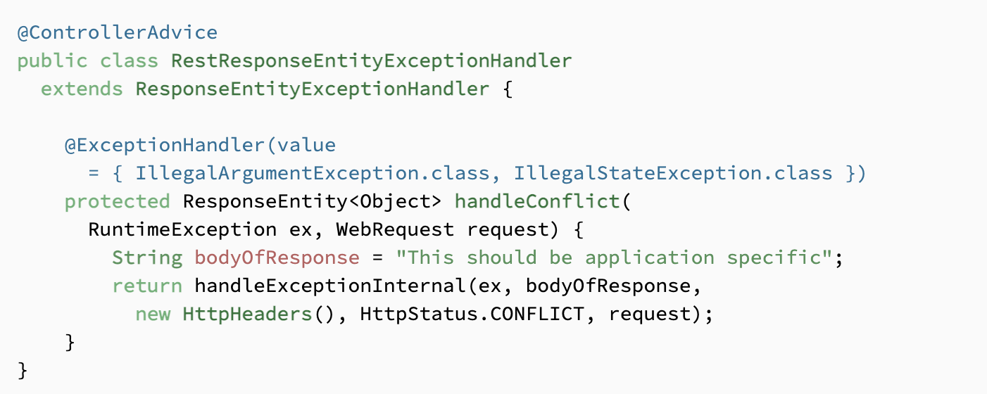
@ControllerAdvice

Slide 23
Links
Thymeleaf
Spring-mvc-tutorial
start spring
Spring-boot-starters
exception-handling

Slide 24
Q&A

